Slide 1

Vehicle Lateral Control
コース１Module 6

Slide 2


•
o o o

Slide 3



Slide 4





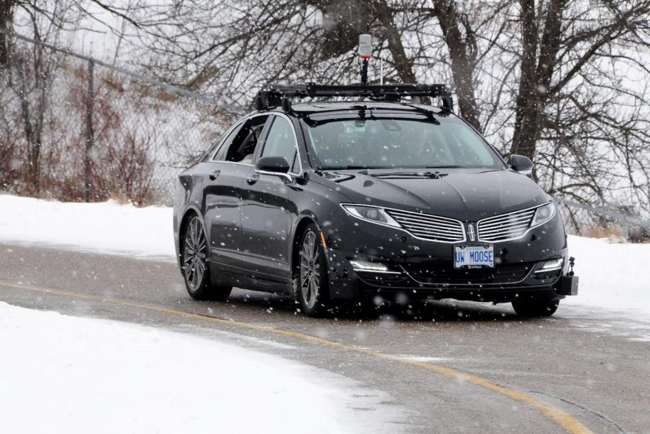
•
o o
o
Lawというのは数式/アルゴリズムでしょう
制限：steering angle limits
Consider the dynamic limitations of vehicle and desired ride characteristics such as maximum lateral acceleration and minimum jerk.
Control command must be cognizant of the available tire forces and not exceed the capabilities of the vehicle when correcting for tracking errors.

Slide 5





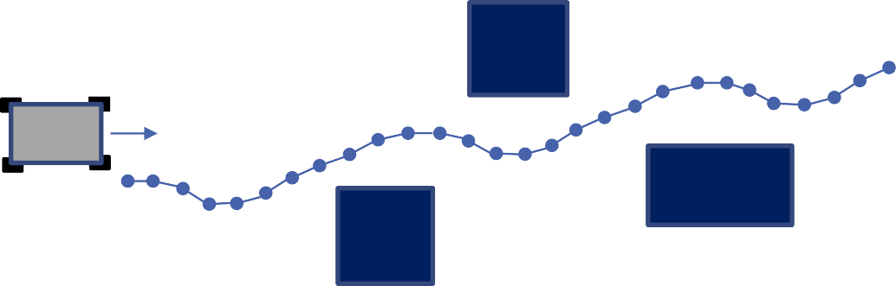


課題：The path includes heading discontinuities, which make precise tracking a challenge with a steered vehicle.
For each of these path definitions, the direction of travel along the path is also provided, which can be encoded with the point ordering or curve ordering.
•
o o o
•
o o
tightly spaced.
This spacing is usually fixed in terms of distance or travel time.
The relative position of the waypoints can be restricted to satisfy an approximate curvature constraint.
Waypoints can be directly constructed from state estimates or GPS waypoints collected in earlier runs of a particular route.
Can be either drawn from a fixed set of motion primitives or can be identified through optimization during planning（コース４で紹介）.
These curves provide the benefit of continuously varying motion, and can be constructed to have smooth derivatives to aid in the consistency of error and error rate calculations.
OpenDriveのgeometryはこのタイプ

Slide 6






•
o o
•
o o
▪
Rely on the geometry and coordinates of the desired path and the kinematic models of the vehicle.
The most popular advanced controller in this category is the model predictive controller or MPC, which performs a finite horizon（有限範囲） optimization to identify the control command to apply.
MPCがよく使われる理由：its ability to handle a wide variety of constraints and to identify optimized solutions that consider more than just the current errors. （いろんな制限や目標を含む最適化ができると思う、幾何学的なcontrollerは主に現在のエラーしか考えない）

Slide 7









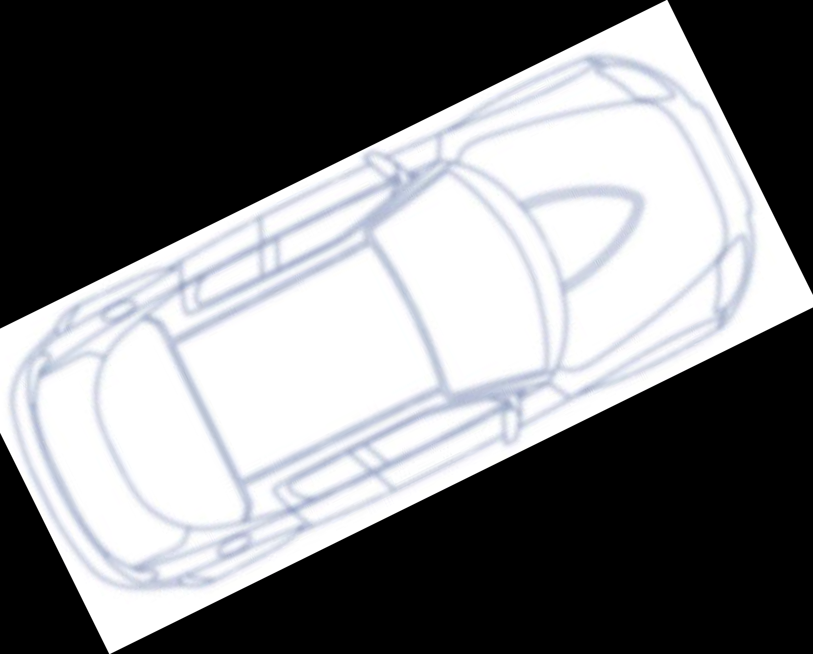

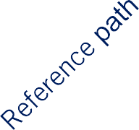


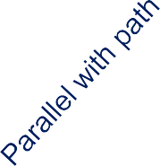
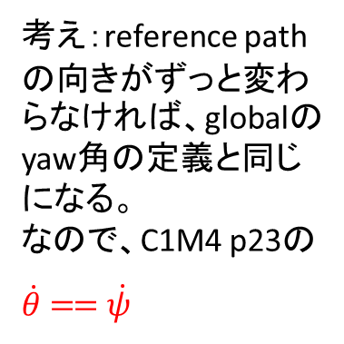
The bicycle model is a suitable control oriented model of a four-wheel vehicle, where the front left and right wheels are combined into a single steerable wheel, and the rear left and right wheels are combined together in a single drive wheel.
•
o
𝑣
𝛿
𝜓
考え：reference pathの向きがずっと変わらなければ、globalのyaw角の定義と同じになる。
なので、C1M4 p23の$\dot{θ}==\dot{ψ}$
cg

Slide 8





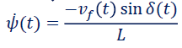
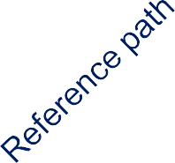
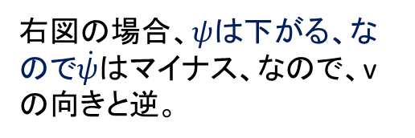
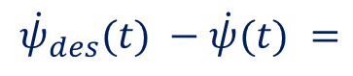

It is a principal measure of how well the vehicle aligned with and moving in the direction of the desired path.
The rate of heading error helps us understand how the heading error evolves over time, and can be computed from the kinematic bicycle model equations.
Here we present the rate of heading error relative to the front axle, as will be used in the Stanley controller.
For straight line segments, the desired heading rate of change is zero, and it can be removed.
•
o
▪
▪
pathがcurveの場合ちょっと複雑：As it is not immediately clear where the reference point on the curved path should lie. 参考点はどこに置くべきか。
To compute the minimum distance to a curved path defined by a spline: Robust and efficient computation of the closest point on a spline curve. http://homepage.divms.uiowa.edu/~kearney/pubs/CurvesAndSurfaces_ClosestPoint.pdf
$$\dot{ψ}$$
前輪中心を見る
𝑣 𝑡 sin 𝛿(𝑡)
𝑣_{𝑓}
$${\dot{ψ}}_{des}(t) −\dot{ψ}(t) =$$
𝑓
𝛿
𝜓
𝐿
C1M4 p23を参考
cg
右図の場合、𝜓は下がる、なので$\dot{ψ}$はマイナス、なので、vの向きと逆。
𝐿

Slide 9








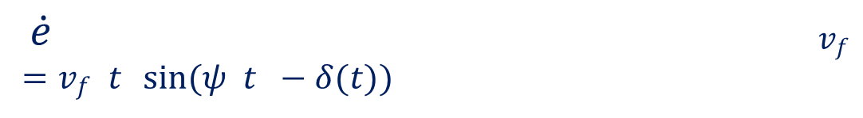


From this equation, as the velocity increases, the crosstrack error changes more quickly, meaning that smaller steering angles are needed to correct for the same size crosstrack errors.
•
o
•
$$\dot{ψ}$$
$\dot{e}$ 𝑣_{𝑓}
= 𝑣_{𝑓} 𝑡 sin(𝜓 𝑡 − 𝛿(𝑡))
𝛿
𝜓
$$\dot{e} t$$
右図の場合、eが下がるので、eの微分はマイナス、なのでvの向きと逆。
cg
𝐿

Slide 10

•
Lateral Control of an Autonomous Vehicle. https://repository.lboro.ac.uk/articles/Lateral_control_of_an_autonomous_vehicle/9225788/1

Slide 11




Slide 12








Geometric Path Tracking Controllerの定義
Any controller that tracks a reference path using only the geometry of the vehicle kinematics and the reference path.
In the case of self-driving cars, a geometric path tracking controller is a type of lateral controller that ignores dynamic forces on the vehicles and assumes the no-slip condition holds at the wheels. kinematicモデルはいつもこの条件。
•
o
o
A reference point along the desired path, which can be the same reference point used to compute heading and crosstrack errors, or it can be a look-ahead point some distance in front of the vehicle along the path. Pure Pursuit（単純追跡、ついせき）はlook-ahead reference pointを使う。 Stanleyはthe same reference point used to compute heading and crosstrack errorsを使 う。
課題：its performance suffers when the vehicle motion does not match the no-slip assumption, as is the case in aggressive vehicle maneuvers with high lateral acceleration. - When the vehicle is operating in the linear tire region and a tire is not saturated（C1M4 p77 Linear Tire Modelを参考）, geometric path tracking controllers can work very well.

Slide 13

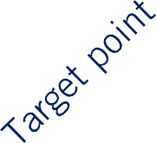



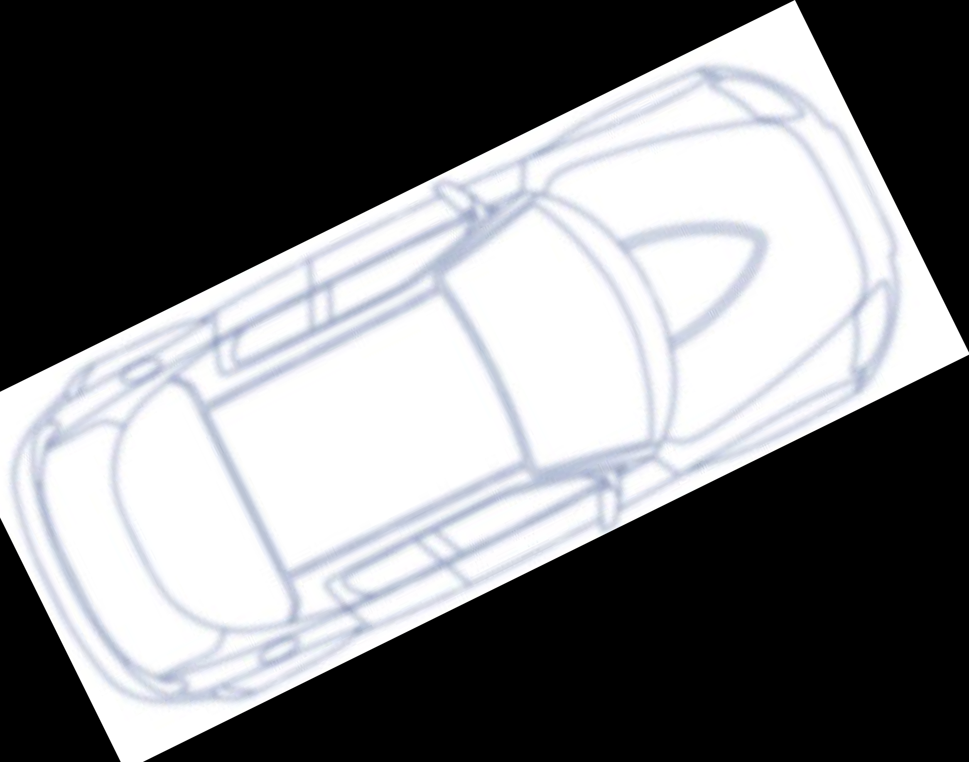
The core idea is that a reference point can be placed on the path a fixed distance ahead of the vehicle, and the steering commands needed to intersect with this point using a constant steering angle can be computed.
As the vehicle turns towards the path to follow this curve, the point continues to move forward, reducing the steering angle and gently bringing the vehicle towards the path.
•
•
𝑙_{𝑑}
𝛼
𝐿
基準点は後輪中心

Slide 14








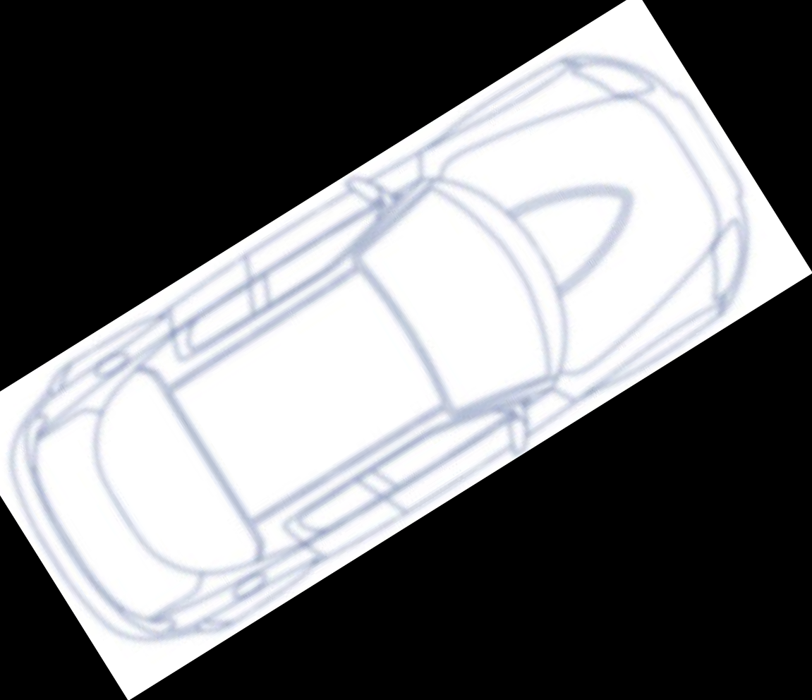


•
•
𝑙_{𝑑}
𝑅
𝑅
=
正弦（せいげん）定理
sin 2𝛼
sin ^{𝜋} − 𝛼
2𝛼
2
𝑅
𝑙_{𝑑}
=
𝑅
𝑙_{𝑑}
2sin 𝛼 cos 𝛼
cos 𝛼
𝑙_{𝑑}
= 2𝑅
𝛼
sin 𝛼
1 2 sin 𝛼
𝜅 = =
𝑅
𝑙_{𝑑}

Slide 15



•
後輪中心を基準点にする場合の式。C1M4 p21を参考、Lは前後輪中心の距離
2 sin 𝛼
𝜅 =
𝛿 = tan⁻¹ 𝜅𝐿
𝑙_{𝑑}
𝑅
2𝛼
2𝐿 sin 𝛼
𝑅
𝛿 = tan⁻¹
𝑙_{𝑑}
𝑙_{𝑑}
𝛼

Slide 16




the curvature of the path created by the pure pursuit controller is proportional to the crosstrack error at the look-ahead reference point.
As the error increases, so does the curvature, bringing the vehicle back to the path more aggressively.
This equation demonstrates that the pure pursuit controller works in a manner similar to proportional control to correct crosstrack error using path curvature as the output of the controller.
•
𝑒
sin 𝛼 =
𝑙_{𝑑}
2 sin 𝛼
𝑅
2
𝜅 = 𝑒
2𝛼
_{𝑙}2
𝜅 =
𝑑
𝑙_{𝑑}
𝑅
𝑙_{𝑑}
𝛼

Slide 17










•
弱点
fixed だと、the selected steering angle would be the same regardless of whether the vehicle is going 10 km/h or 100km/h, leading to very different lateral accelerations.
A controller tuned for high-speed would be far too sluggish（動きののろい（鈍い）） at low speed, and one tuned for low speed would be dangerously aggressive at high speeds.
解決策は次へ
$$\frac{2}{l_{d}^{2}}$$
•
𝑙_{𝑑}

Slide 18







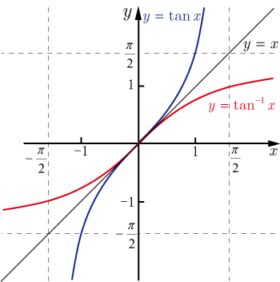
𝑙_{𝑑}
•
𝑙_{𝑑} = 𝐾_{𝑑𝑑}𝑣_{𝑓}
The controller selects the steering angle that will form an arc to the look-ahead reference point, and adjusts this look-ahead point to be further away the faster the vehicle is traveling.
2𝐿 sin 𝛼
2
𝜅 = 𝑒
𝛿 = tan⁻¹
_{𝑙}2
𝑙
𝑑
𝑑
𝑅
2𝛼
𝑅
2𝐿 sin 𝛼
𝑙_{𝑑}
𝛿 = tan⁻¹
𝛼
^{𝐾}𝑑𝑑^{𝑣}𝑓
Forward velocity

Slide 19

•
Automatic Steering Methods for Autonomous Automobile Path Tracking. CMUだから重要 https://www.ri.cmu.edu/pub_files/2009/2/Automatic_Steering_Methods_for_Autonomous_Automobile_Path_Tracking.pdf

Slide 20




Slide 21

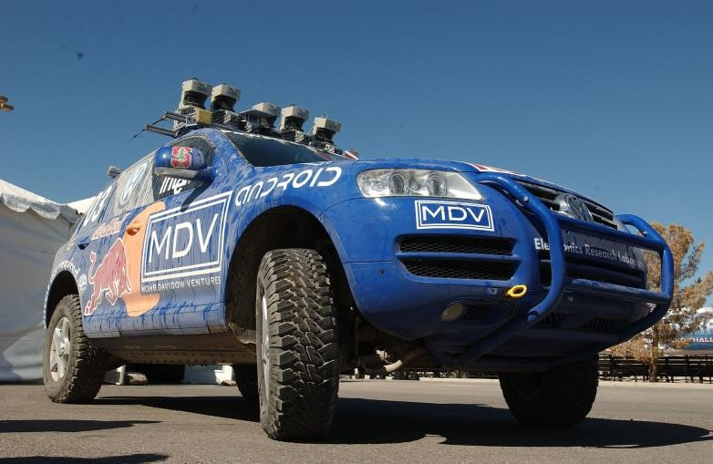






•
o
o
o
▪
▪
▪
Look-ahead distanceを使わず
単純追跡は単純にreferenceに戻りたい、headingエラーは特に考えてないと思う。

Slide 22




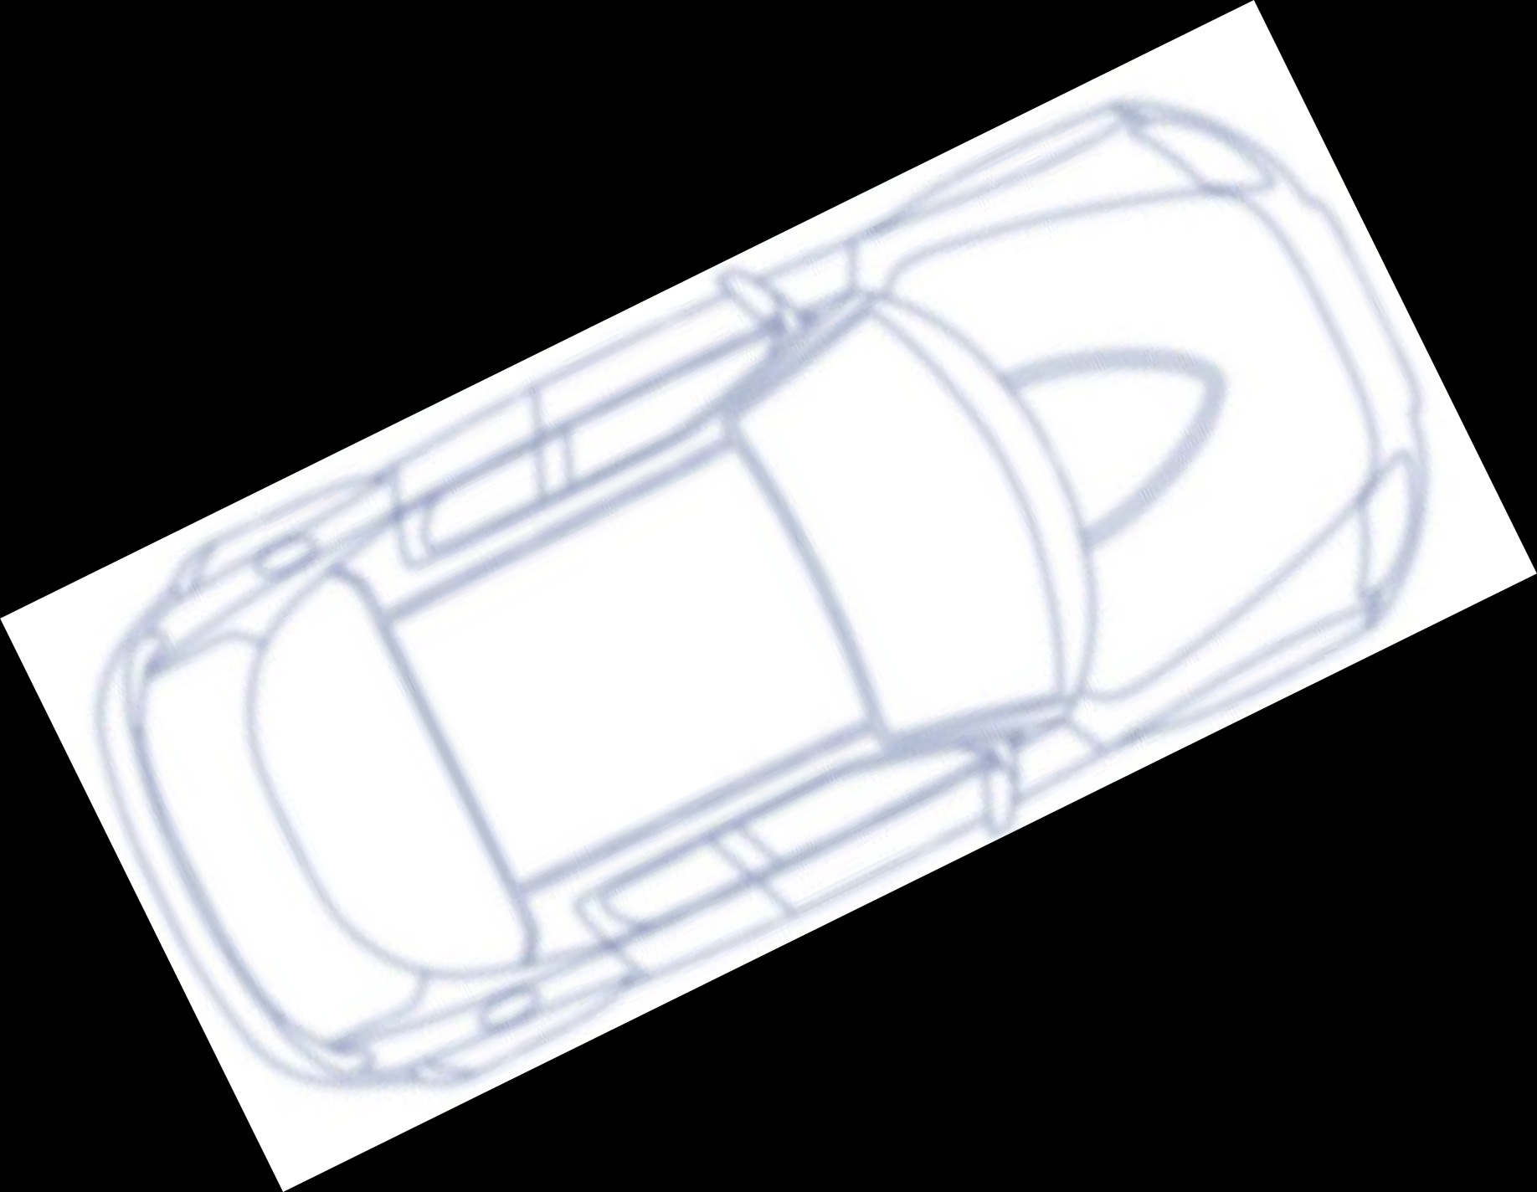
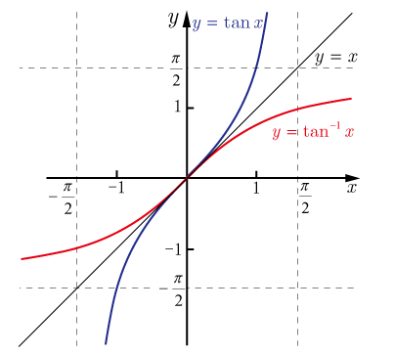

•
o
The independent penalization（罰） of heading and crosstrack errors and the elimination of the look-ahead distance make this a different approach from pure pursuit.
𝛿 𝑡
= 𝜓(𝑡)
o
𝑣_{𝑓}
▪
▪
▪
▪
𝛿
𝜓
反比例、はんぴれい
逆タンジェント
この式の推論はない、いくつかの目的を満たすように仮定したんだ
𝑘𝑒(𝑡)
𝛿 𝑡 = tan⁻¹
𝑣_{𝑓}(𝑡)
𝐿
o
𝛿(𝑡) ∈
^{𝛿}𝑚𝑖𝑛^{, 𝛿}𝑚𝑎𝑥

Slide 23



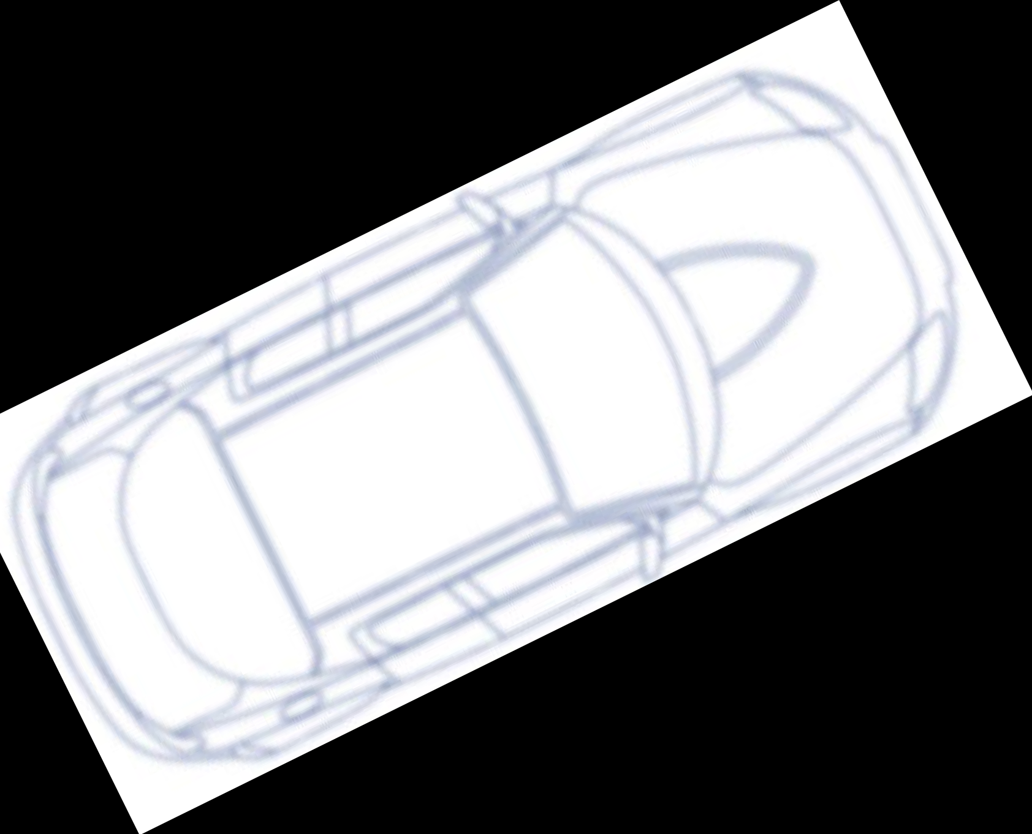

•
𝑘𝑒(𝑡)
𝛿 𝑡
= 𝜓 𝑡
+ tan⁻¹
,
𝛿(𝑡) ∈
^{𝛿}𝑚𝑖𝑛^{, 𝛿}𝑚𝑎𝑥
𝑣_{𝑓}(𝑡)
•
o o
𝑣_{𝑓}
𝜓
𝜓が大きい場合
𝛿

Slide 24





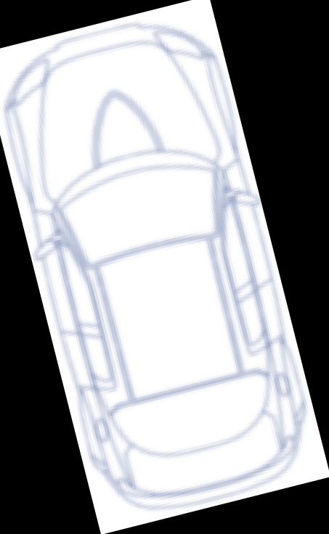


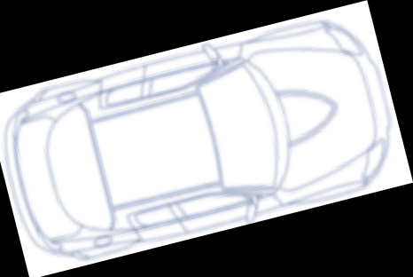


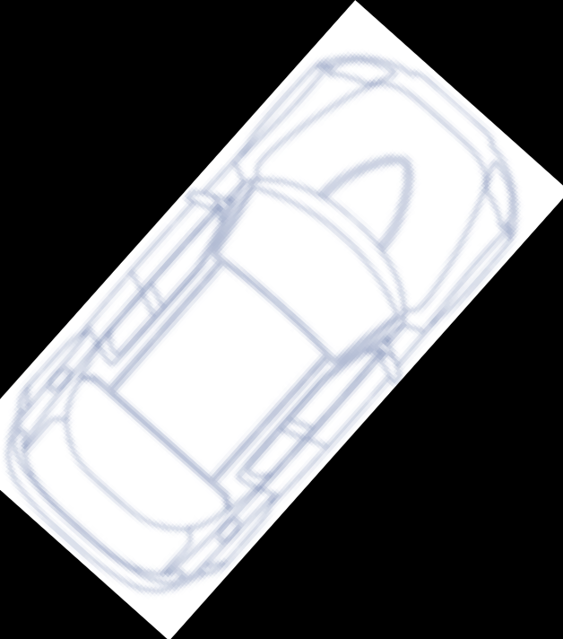
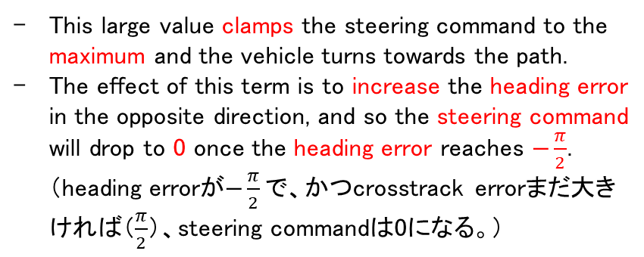
This large value clamps the steering command to the maximum and the vehicle turns towards the path.
The effect of this term is to increase the heading error in the opposite direction, and so the steering command will drop to 0 once the heading error reaches $−\frac{π}{2}$. （heading errorが$−\frac{π}{2}で$、かつcrosstrack errorまだ大きければ（$\frac{π}{2}$）、steering commandは0になる。）
𝑒が大きい場合
⾃⾞が今pathの左側にいる。つまり$\frac{π}{2}$は時計回り？
•
𝑣_{𝑓}
𝛿
𝑘𝑒(𝑡)
𝜋
≈
𝜋
→ 𝛿 𝑡 ≈ 𝜓 𝑡 +
tan⁻¹
𝑣_{𝑓}(𝑡)
2
2
o
相殺（そうさい）する
𝜓
crosstrackエラーが⼤きすぎると、headingの補正は全然無くなって、⾞が最⼤steering angleで⼀⽣懸命path に戻りたい！その後、crosstrackエラーが下がって、そんなに⼀⽣懸命戻る必要がない時、またheadingの補正がメインになる。
o
𝜓
𝛿

Slide 25
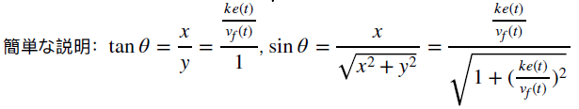




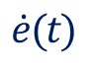
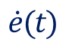
•
𝑘𝑒(𝑡)
The crosstrack error evolution follows a first-order differential equation（一階微分方程式）, and the solution for this ODE is an exponential（指数関数的、しすう）.
Since k is positive, the error decays exponentially to 0.
The most interesting aspect of this investigation is that the decay rate（減衰率） is completely independent of the speed.
So faster vehicles will travel farther while converging（収束） to the path, but will converge to the path at the same time as slower moving vehicles.
$$\dot{e}(t)$$
= −𝑣
𝑓
𝑡 sin 𝜓 𝑡 − 𝛿(𝑡)
= −𝑣 𝑡 sin tan⁻¹
𝑓
𝑣_{𝑓}(𝑡)
この式についてP9を参考
−𝑘𝑒(𝑡)
=
𝑘𝑒(𝑡)
𝑣_{𝑓}
2
1 +
•
$$\dot{e}(t)$$
≈ −𝑘𝑒(𝑡)

Slide 26





•
o o
𝑣_{𝑓}
𝛿
𝜓
𝐿

Slide 27










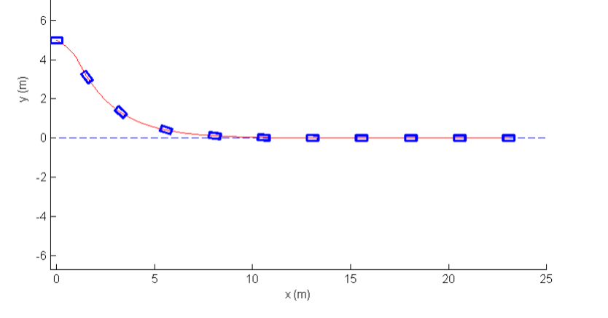
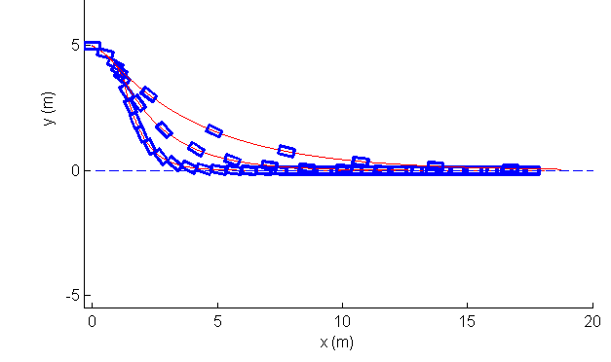


左Simulation図
The large initial error leads to a large steering command that quickly turns the vehicle towards the path.
The heading error and crosstrack error terms then reach an equilibrium（釣り合い）, and the vehicle continues in a straight line towards the path.
As the crosstrack error decreases, the exponential decay to the path becomes visible.
右Simulation図
Run the same simulation at different forward velocities.
In all cases, the turn towards the path, straight line progress and then exponential decay to the path are visible.
The higher the speed, the further the car travels before reaching the path.
But the final convergence for small crosstrack errors takes the same amount of time in each case.
•
o
o 𝛿 = 25^{𝑜}
o 𝑘 = 2.5
o
𝑣 = 5m/s
𝑓
𝐿 = 1 𝑚
𝑣 = 2, 5, 10m/s
𝑓
2m/s
5m/s
この滑らかな緩和は指数減衰の結果
10m/s
注意：crosstrackエラーの指数減衰はcrosstrackエラーが小さい時のみ発生

Slide 28
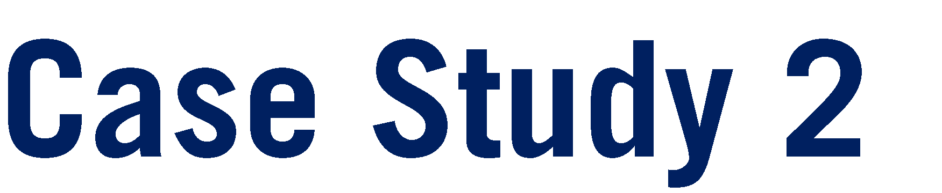





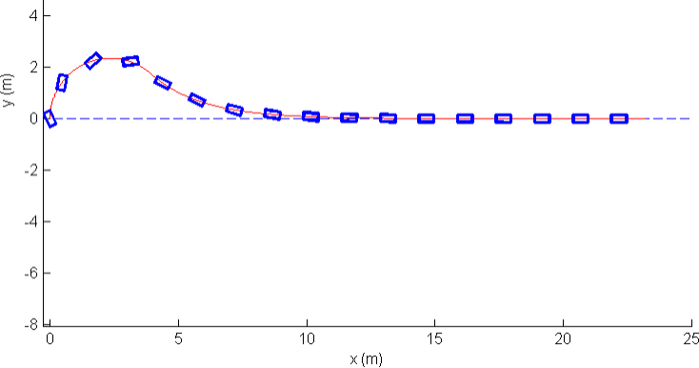



First, the steering command is up against its limit as the heading error is corrected.
Then as the crosstrack error starts to grow, the steering commands continue to correct the heading of the car beyond the alignment with the path.
Finally, the car enters the exponential convergence segment as before.
In fact, it comes with a global stability proof, meaning that no matter what the initial conditions, the controller will guide the car back to its path. どんな初期条件でもStanleyコントローラは車をパスへ導く。
In practice however, the Stanley controller is still a geometric path tracking controller, and as such does not consider many different aspects of real self-driving car.
For example, it does not consider noisy measurements, actuator dynamics or tire force effects, all of which can cause undesirable ride characteristics during maneuvers. ADSTでやっていたモデルの制御はすべて幾何学的コントローラなので、これらの弱みは全部存在するはず。
•
▪
▪
𝛿 = 25^{𝑜}
𝑘 = 2.5
𝑣 = 5 ^{𝑚}
𝑓
𝑠
𝐿 = 1𝑚
最大steering angle制限

Slide 29



背景：During low-speed operation, the pure pursuit and Stanley controllers can behave quite aggressively when confronted with noisy velocity estimates. 低速こそノイズに弱い。
Errors in low speed estimates tend to get amplified in the steering command.
This leads to wild swings(激しい変動) in the steering wheel, which is not desirable for rider comfort（快適）.
•
o o
背景：At higher speeds, the issue that steering commands need to vary slowly to ensure lateral forces are not excessive.
Even with this scaling on speeds, Stanley’s response was overly aggressive at high speeds, and so a damping term on heading rate was also added.
This essentially converts the heading error control portion to a PD controller, and the same idea can be applied to the pure pursuit control of curvature as well.
𝑘𝑒(𝑡)
𝛿 𝑡 = 𝜓 𝑡 + tan⁻¹
𝑘_{𝑠} + 𝑣_{𝑓}(𝑡)
•
o
•
o
Dの特徴はまさにダンピングだ
Feedforwardはいつも固有部分が存在する時に有用、例えば速度維持だけで必要なスロットル。
結論：
With these modifications, the Stanley controller becomes a useful tool for moderate（適度な） driving tasks as long as the vehicle avoids exiting the linear tire region.
Define paths that are safe to track in the 4th course.
Add further enhancements that improve the controllers’ real-world performance.
背景：For curved paths with high curvature, the controller fails to track them well as the reference dynamics were not considered in the derivation of the geometric controllers.
- Improves tracking on curves by adding a feedforward term on heading. つまりpathのheading

Slide 30





•
•
•
Stanley Controller論⽂：Autonomous Automobile Trajectory Tracking for Off-Road Driving: Controller Design, Experimental Validation and Racing: http://ai.stanford.edu/~gabeh/papers/hoffmann_stanley_control07.pdf

Slide 31




Slide 32

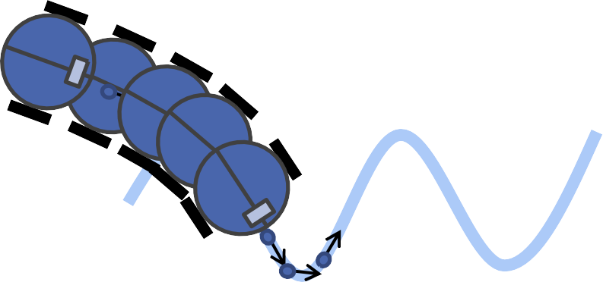



Because solving an optimization problem at each time step can take time, MPC was originally applied to slow processes such as industrial chemical processing.
However, the ever-improving performance of today’s computing hardware has made MPC a viable approach even on embedded hardware.
More and more automotive applications are turning to MPC as a way to improve performance and expand operating range for a suite of different embedded controllers, from traction control（発進・加速時のタイヤの空転を防止）, and stability control（横滑り防止）, to emission reduction（排気）, and idle（アイドル） speed control. 色んなコントローラが段々MPCを採用してきた。
Longitudinal and lateral control for autonomous vehicles is another extremely suitable application for MPC.
•
o
o
•
o o o
•
o
後退する
Model Predictive Control is often interchangeably（交換可能） referred to as Receding Horizon Control, since the controller generates an actuator signal based on a fixed finite length horizon（固定有限時間区間） at each time-step which receives as time moves forward.
Meaning that we can use the same approach even as our models change or improve over time.
Requiring the definition of an objective function and relevant constraints that are then optimized using well-established solvers（ソルバー）.
The states and control signals can be constrained to stay within safe operating bounds and controls can be selected to maximize multiple objectives simultaneously.
Both hard constraints and soft penalties can be employed, leading to a rich set of solutions for constrained control problems.
As many automotive subsystems have rigid actuator constraints and diverse performance objectives, MPC has emerged as a major tool for vehicle control.

Slide 33






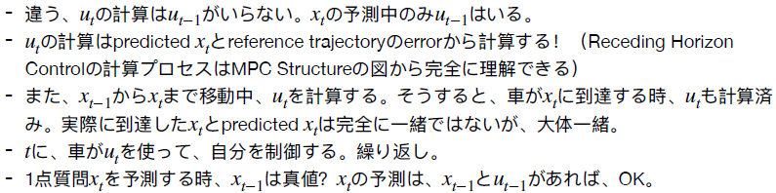






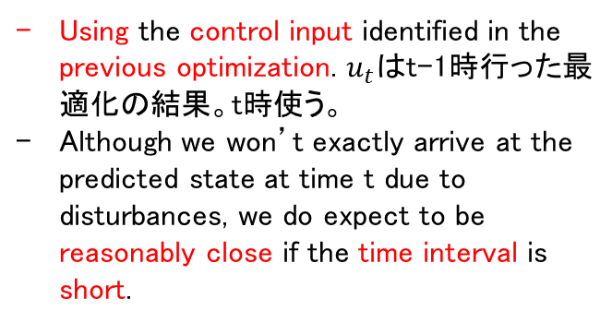
タスク： Receding Horizon Control solves a fixed size optimization at each time-step, which identifies optimal control inputs to apply from the current time to the end of the horizon based on the objectives’ constraints and current state of the vehicle.
課題： Because optimization can take some amount of time, the state of the vehicle when starting the optimization, will be different from the state of vehicle when completing the optimization. 計算が時間かかる
対策： As a result, must use a predicted state in the optimization for the time at which the control input will actually be applied.
•
o o o
T
t
Using the control input identified in the previous optimization. $u_{t}は$t-1時行った最適化の結果。t時使う。
Although we won’t exactly arrive at the predicted state at time t due to disturbances, we do expect to be reasonably close if the time interval is short.
x_{t}
▪
t T
^{x}t-1
x_{t}
▪
u_{t}
t
^{x}t-1
^{u}t-1
x_{t}
u_{t}
u_{t}
x_{t}
t-1
t

Slide 34














start: x(t)_true
end: x(t+1)_true
Current inputsやStatesは常に同じタイミング
x(t+1)_predicted, まだ走行中、本当のx(t+1)まだ分からない
x(t+1)_referenced
start：u(t)
end: u(t+1)
ここで時間がかかるので、車移動中、周期も変わる
The model then outputs predicted states at the next time-step, which are compared to the reference trajectory and passed into the optimizer as the future or predicted error.
The optimizer also receives updated constraints and the cost function to use, which can be fixed in advance or varied based on changing operating modes.

Slide 35




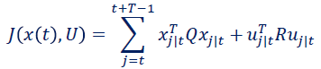

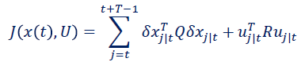
𝑥_{𝑡+1} = 𝐴𝑥_{𝑡} + 𝐵𝑢_{𝑡}
•
予測用
最小化の場合：
If all the states are to be driven to zero（つまり最適化は最⼩化）, the objective function or cost function when we minimize, can be defined as: with quadratic error on both deviations of the state from zero and on non-zero control inputs（0からの偏差を罰する）.
This is similar to the optimization problem of optimal control theory and trades off control performance and input aggressiveness.
the matrices Q and R can be selected to achieve a particular type of response.
•
^{𝑈 = {𝑢}𝑡|𝑡^{, 𝑢}𝑡+1|𝑡^{, 𝑢}𝑡+2|𝑡, … }
•
•
トラッキングの場合：
^{𝛿𝑥}𝑗|𝑡 ^{=𝑥}𝑗|𝑡,𝑑𝑒𝑠 ^{− 𝑥}𝑗|𝑡
This is a famous optimization formulation and has a closed form solution, the Linear Quadratic Regulator（線形二次レギュレータ） or LQR.

Slide 36


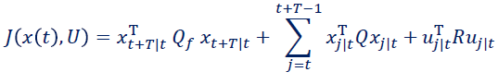


•
この項の意図わからないが、有限範囲のみだそう
min
𝑈≜{𝑢_{𝑡|𝑡},𝑢_{𝑡+1|𝑡},… }
𝑠. 𝑡.
^{𝑥}𝑗+1|𝑡 ^{= 𝐴𝑥}j|𝑡 ^{+ 𝐵𝑢}j|𝑡 ,
𝑡 ≤ 𝑗 ≤ 𝑡 + 𝑇 − 1
Linear MPC最適化の答え、参考： https://en.wikipedia.org/wiki/Linear%E2%80%93quadratic_regulator
•
o o o
𝑢_{𝑡} = −𝐾𝑥_{𝑡}
Full state feedbackの意味：all states are used in the control response.
Can be computed from the A and B matrices of the state-space model and the Q and R matrices of the cost function.
[NeurIPS 2018] Differentiable MPC for End-to-end Planning and Control
https://arxiv.org/abs/1810.13400

Slide 37

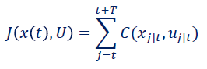
•
min
𝑈≜{𝑢_{𝑡|𝑡},𝑢_{𝑡+1|𝑡},… }
non-linear dynamic models of motion
𝑠. 𝑡.
^{𝑥}𝑗+1|𝑡 ^{= 𝑓 𝑥}𝑗|𝑡^{, 𝑢}𝑗|𝑡
,
𝑡 ≤ 𝑗 ≤ 𝑡 + 𝑇 − 1
𝑡 ≤ 𝑗 ≤ 𝑡 + 𝑇 − 1
𝑡 ≤ 𝑗 ≤ 𝑡 + 𝑇 − 1
𝑡 ≤ 𝑗 ≤ 𝑡 + 𝑇 − 1
𝑡 ≤ 𝑗 ≤ 𝑡 + 𝑇 − 1
state bounds
^{𝑥}𝑚𝑖𝑛 ^{≤ 𝑥}𝑗+1|𝑡
≤ 𝑥_{𝑚𝑎𝑥} ,
input bounds
^{𝑢}𝑚𝑖𝑛 ^{≤ 𝑢}𝑗|𝑡
^{𝑔 𝑥}𝑗|𝑡^{, 𝑢}𝑗|𝑡 ^{ℎ 𝑥}𝑗|𝑡^{, 𝑢}𝑗|𝑡
≤ 𝑢_{𝑚𝑎𝑥} ,
≤ 0,
= 0,
inequality constraints（不等式制約）
Neural Networkの最適化も閉形式（closed-form）の解答がないので、Gradient Descentで最適化している（numerically）。
equality contraints（等式制約）
制約はこの2種類
•
Even the kinematic bicycle model falls into this category.
So almost all MPC controllers for autonomous driving will be solved numerically（数値的に）.

Slide 38





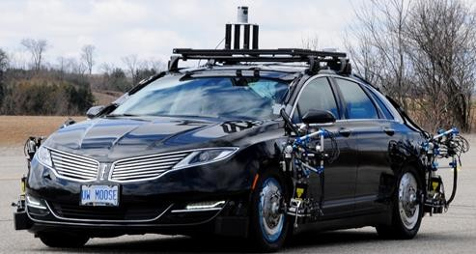








𝐹_{𝑥}
Include the conversion from the tire forces to throttle, brake, and steering commands as a low level controller inside the loop. （tire forceからthrottle, brake, steeringへの変換は紹介してくれてない。C1M5 p22はdesired accelerationからthrottleへ変換するlower-level controller）
The inputs to the MPC block are the reference trajectory, which include the reference path and velocity, as well as the vehicle states at each time step.
The output of the MPC block are the lateral and longitudinal forces needed to follow the desired trajectory.
Finally, the actuation signals are applied to the vehicle at each time-step, and a new vehicle state is achieved closing the feedback loop.
（MPCを使うlateral control）
Reference Trajectory
Throttling Braking
𝐹_{𝑦}
Steering
States (measured or estimated)

Slide 39




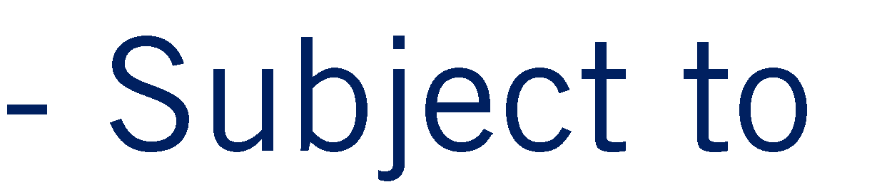







（流れ）
•
o o
•
o o
•
o o o o
つまりMPCのoutputはLongitudinal/Lateral forceではなく、Throttle/Braking/Steering commandになる。
A large optimization problem that may be challenging to solve in real time.

Slide 40

The tracking performance with the MPC controller is excellent, lagging slightly, but without overshoot or oscillation（振動）.
Lane changeまた戻る
•
Lateral Motion
Velocity – Longitudinal
Velocity – Lateral

Slide 41
MPC can be used without modification for a wide range of operating conditions and a large variety of scenarios.
コスト：increased computational requirements and relies on the availability of robust optimization solvers to always return feasible solutions in the available time window.
Tire Forces
Yaw Rate

Slide 42
•
•
•
Predictive Active Steering Control for Autonomous Vehicle Systems: https://ieeexplore.ieee.org/document/4162483
https://borrelli.me.berkeley.edu/pdfpub/pub-2.pdf
MatLabのModel Predictive Control Toolbox：https://jp.mathworks.com/products/model-predictive-control.html
見つけたpython MPCツールボックス（TU Dortmund, TU Berlin開発）：https://www.do-mpc.com/en/latest/index.html

Slide 43





•
•
•
•

